Slide 1

The Calculation of $A^{−1}$: The Gauss–Jordan Method
.

Slide 2
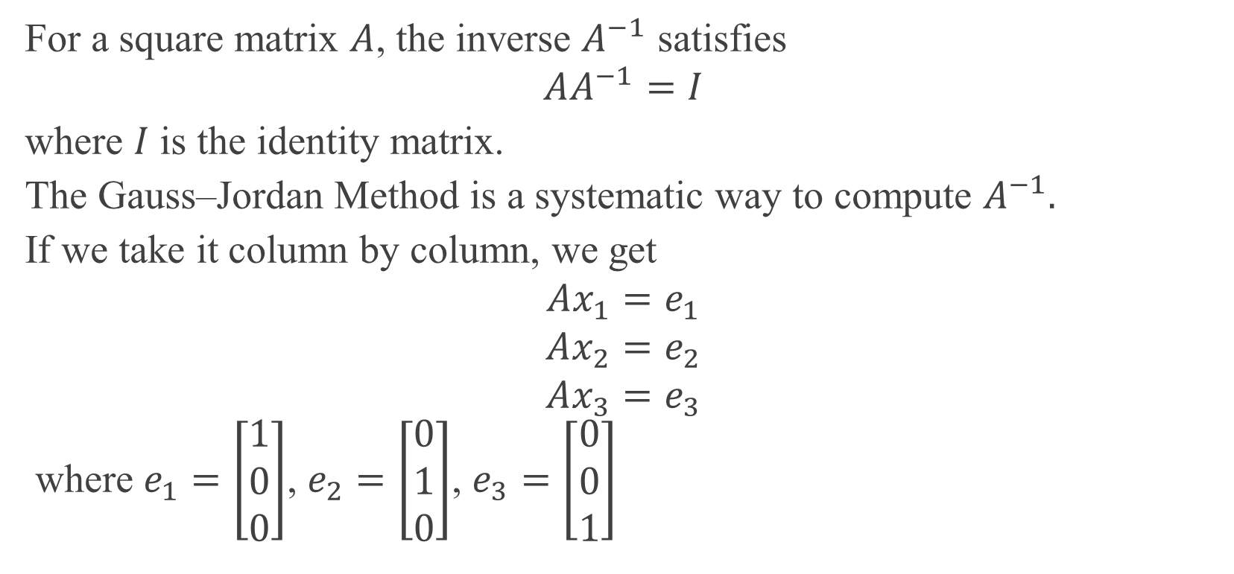
Inverse of a Matrix
For a square matrix $A$, the inverse $A^{−1}$ satisfies
$$AA^{−1}=I$$
where $I$ is the identity matrix.
The Gauss–Jordan Method is a systematic way to compute $A^{−1}.$
If we take it column by column, we get
$$Ax_{1}=e_{1}$$
$$Ax_{2}=e_{2}$$
$$Ax_{3}=e_{3}$$
​ where $e_{1}=\left[\begin{matrix}1 \\ 0 \\ 0\end{matrix}\right]$, $e_{2}=\left[\begin{matrix}0 \\ 1 \\ 0\end{matrix}\right]$, $e_{3}=\left[\begin{matrix}0 \\ 0 \\ 1\end{matrix}\right]$

Slide 3
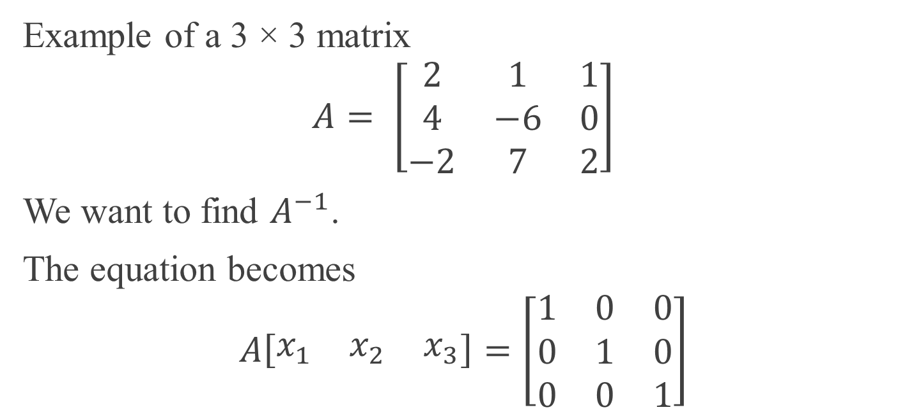
Example Matrix
Example of a 3 × 3 matrix
$$A= \left[\begin{matrix}2 & 1 & 1 \\ 4 & −6 & 0 \\ −2 & 7 & 2\end{matrix}\right]$$
We want to find $A^{−1}$.
The equation becomes
$$A\left[\begin{matrix}x_{1} & x_{2} & x_{3}\end{matrix}\right]=\left[\begin{matrix}1 & 0 & 0 \\ 0 & 1 & 0 \\ 0 & 0 & 1\end{matrix}\right]$$

Slide 4
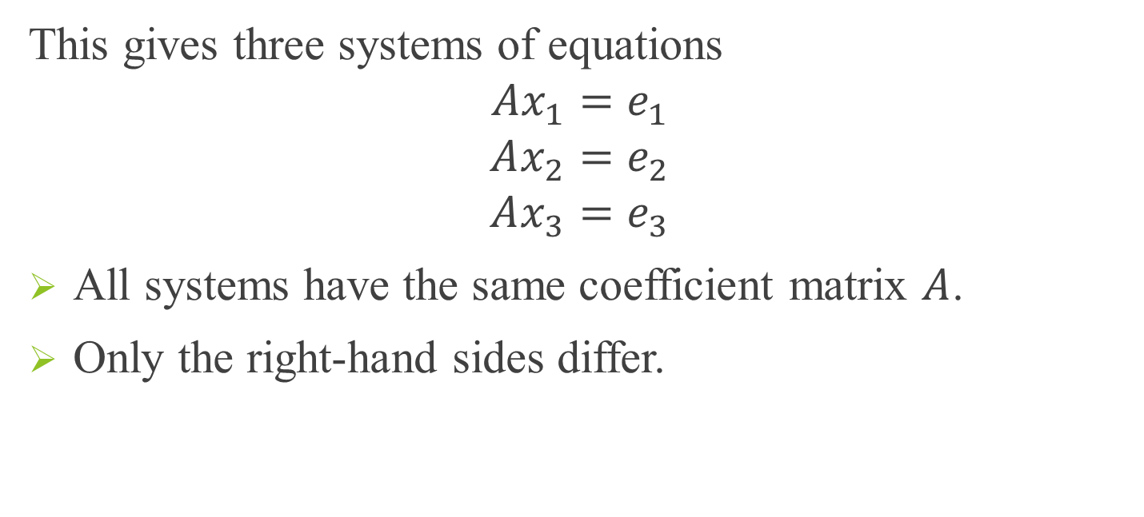
Systems of Equations
This gives three systems of equations
$$Ax_{1}=e_{1}$$
$$Ax_{2}=e_{2}$$
$$Ax_{3}=e_{3}$$
All systems have the same coefficient matrix $A$.
Only the right-hand sides differ.

Slide 5
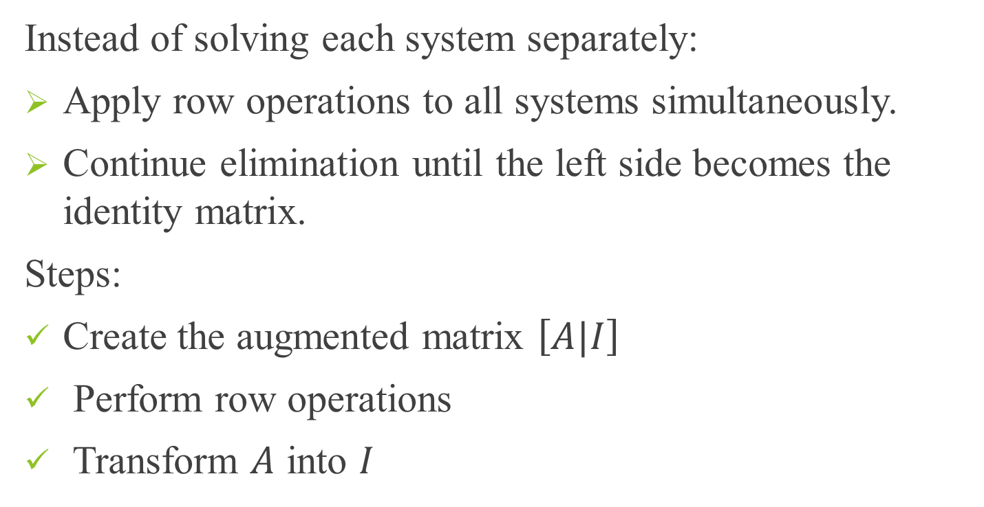
Gauss–Jordan Method
Instead of solving each system separately:
Apply row operations to all systems simultaneously.
Continue elimination until the left side becomes the identity matrix.
Steps:
Create the augmented matrix $\left[A|I\right]$
Perform row operations
Transform $A$ into $I$

Slide 6
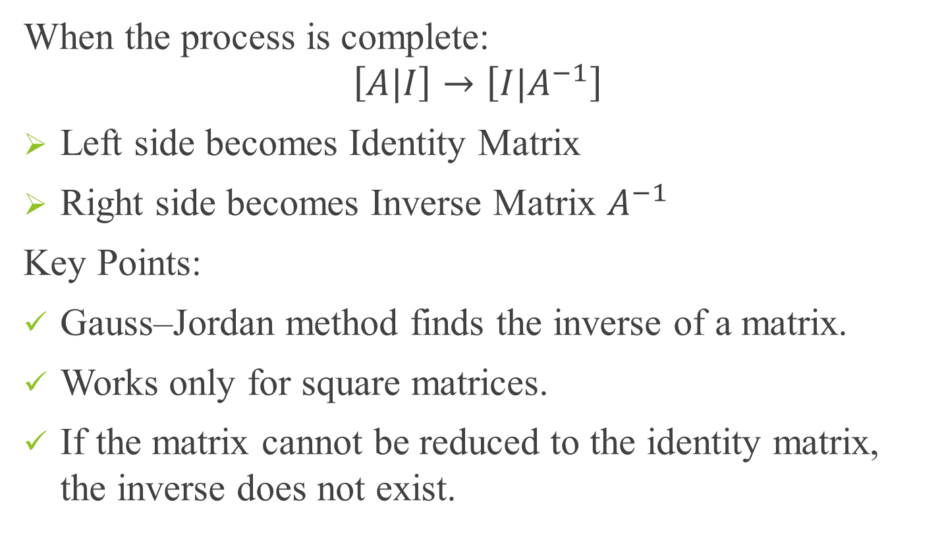
Final Result
When the process is complete:
$$\left[A|I\right]→\left[{I|A}^{−1}\right]$$
Left side becomes Identity Matrix
Right side becomes Inverse Matrix $A^{−1}$
Key Points:
Gauss–Jordan method finds the inverse of a matrix.
Works only for square matrices.
If the matrix cannot be reduced to the identity matrix, the inverse does not exist.

Slide 7
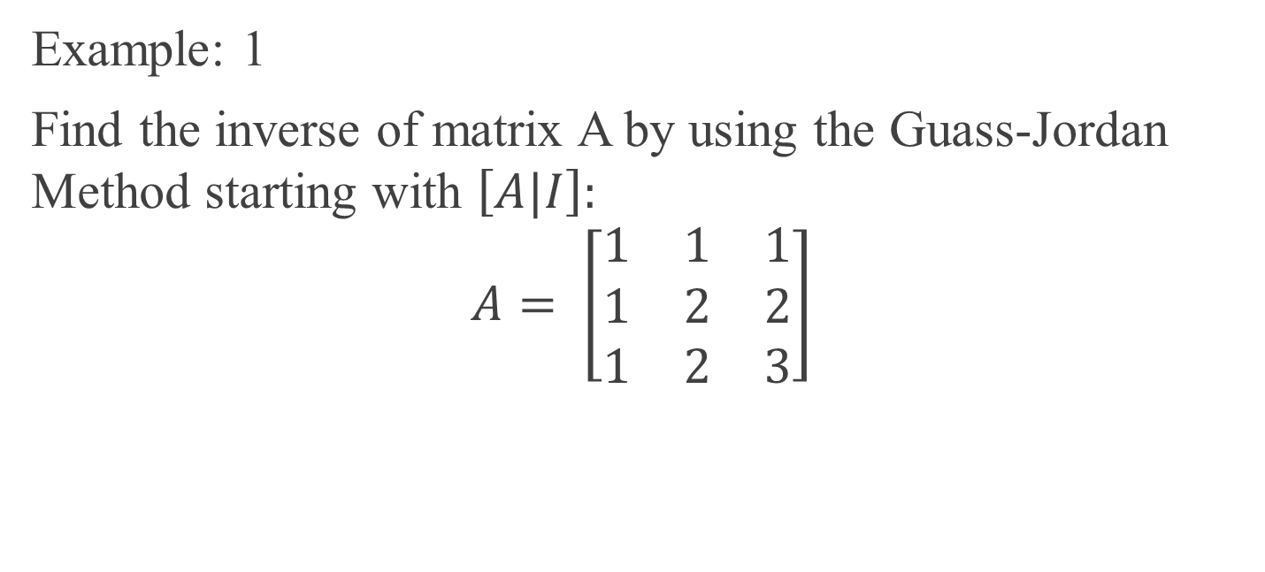
Finding the Inverse of a Matrix using the Gauss–Jordan Method
Example: 1
Find the inverse of matrix A by using the Guass-Jordan Method starting with $\left[A|I\right]:$
$$A= \left[\begin{matrix}1 & 1 & 1 \\ 1 & 2 & 2 \\ 1 & 2 & 3\end{matrix}\right]$$

Slide 8

Given matrix $$A= \left[\begin{matrix}1 & 1 & 1 \\ 1 & 2 & 2 \\ 1 & 2 & 3\end{matrix}\right]$$ To find $A^{−1}$ we start with the augmented matrix $\left[A|I\right]$.
Step 1: Form Augmented Matrix
$$\left[\begin{matrix}\begin{matrix}1 & 1 & 1 \\ 1 & 2 & 2 \\ 1 & 2 & 3\end{matrix} & \begin{matrix}| \\ | \\ |\end{matrix} & \begin{matrix}1 & 0 & 0 \\ 0 & 1 & 0 \\ 0 & 0 & 1\end{matrix}\end{matrix}\right]$$

Slide 9
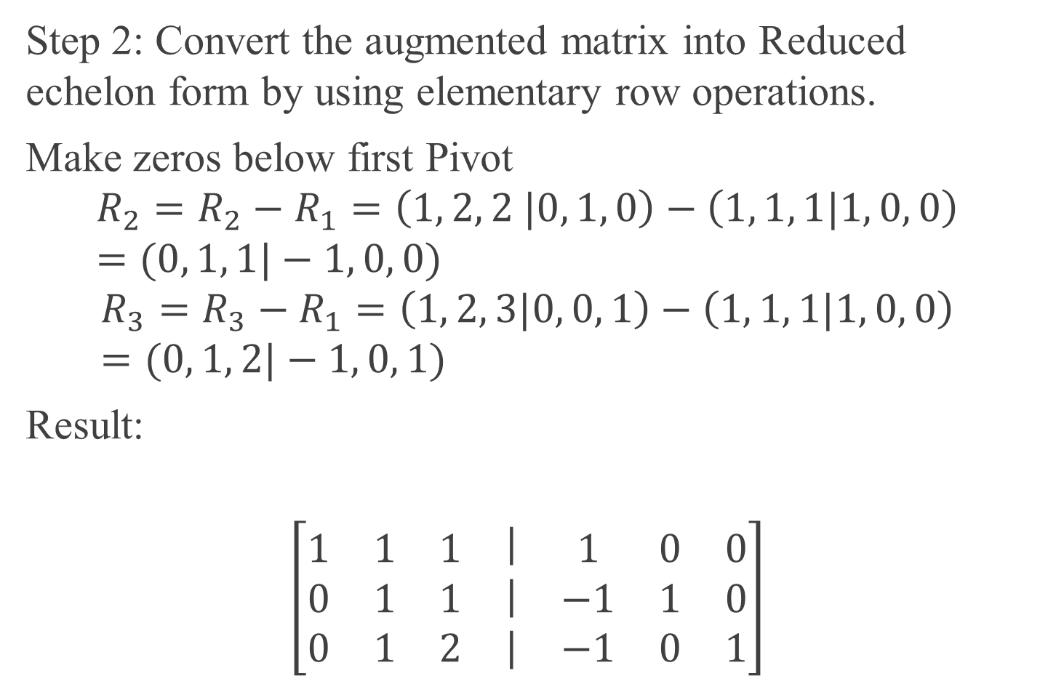
.
Step 2: Convert the augmented matrix into Reduced echelon form by using elementary row operations.
Make zeros below first Pivot
$$R_{2}=R_{2}−R_{1}=\left(1, 2, 2 |0, 1, 0\right)−\left(1, 1, 1|1, 0, 0\right)=(0, 1, 1|−1, 0, 0)$$
$$R_{3}=R_{3}−R_{1}=\left(1, 2, 3|0, 0, 1\right)−\left(1, 1, 1|1, 0, 0\right)=(0, 1, 2|−1, 0, 1)$$
Result:
$$\left[\begin{matrix}\begin{matrix}1 & 1 & 1 \\ 0 & 1 & 1 \\ 0 & 1 & 2\end{matrix} & \begin{matrix}| \\ | \\ |\end{matrix} & \begin{matrix}1 & 0 & 0 \\ −1 & 1 & 0 \\ −1 & 0 & 1\end{matrix}\end{matrix}\right]$$

Slide 10

.
Eliminate below second Pivot
$$R_{3}=R_{3}−R_{2}$$
Result:
$$\left[\begin{matrix}\begin{matrix}1 & 1 & 1 \\ 0 & 1 & 1 \\ 0 & 0 & 1\end{matrix} & \begin{matrix}| \\ | \\ |\end{matrix} & \begin{matrix}1 & 0 & 0 \\ −1 & 1 & 0 \\ 0 & −1 & 1\end{matrix}\end{matrix}\right]$$

Slide 11

.
Eliminate above third Pivot
$$R_{2}=R_{2}−R_{3}$$
$$R_{1}=R_{1}−R_{3}$$
Result:
$$\left[\begin{matrix}\begin{matrix}1 & 1 & 0 \\ 0 & 1 & 0 \\ 0 & 0 & 1\end{matrix} & \begin{matrix}| \\ | \\ |\end{matrix} & \begin{matrix}1 & 1 & −1 \\ −1 & 2 & −1 \\ 0 & −1 & 1\end{matrix}\end{matrix}\right]$$

Slide 12

.
Eliminate above second Pivot
$$R_{1}=R_{1}−R_{2}$$
Result:
$$\left[\begin{matrix}\begin{matrix}1 & 0 & 0 \\ 0 & 1 & 0 \\ 0 & 0 & 1\end{matrix} & \begin{matrix}| \\ | \\ |\end{matrix} & \begin{matrix}2 & −1 & 0 \\ −1 & 2 & −1 \\ 0 & −1 & 1\end{matrix}\end{matrix}\right]$$

Slide 13
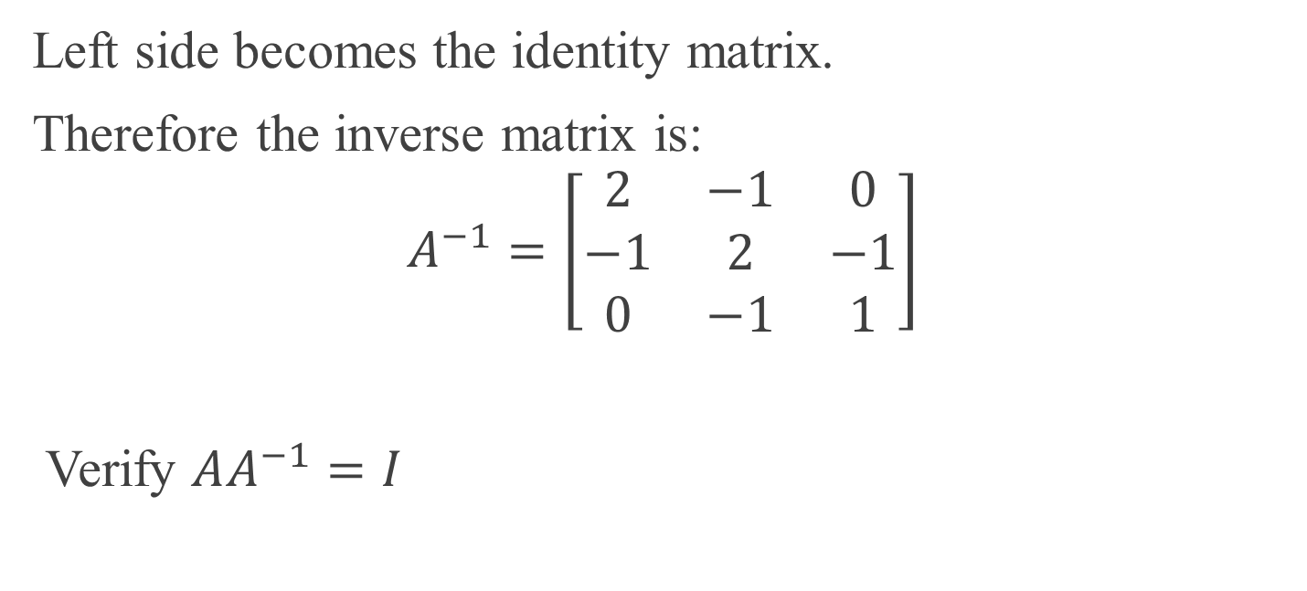
.
Left side becomes the identity matrix.
Therefore the inverse matrix is:
$$A^{−1}=\left[\begin{matrix}2 & −1 & 0 \\ −1 & 2 & −1 \\ 0 & −1 & 1\end{matrix}\right]$$
Verify $AA^{−1}=I$

Slide 14
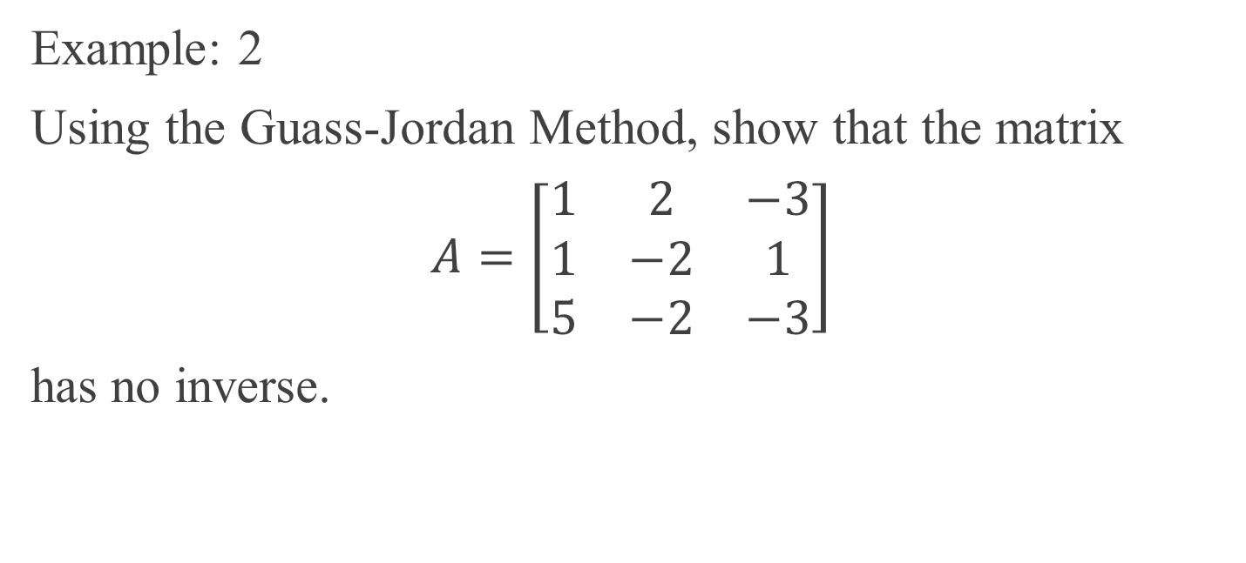
.
Example: 2
Using the Guass-Jordan Method, show that the matrix
$A=\left[\begin{matrix}1 & 2 & −3 \\ 1 & −2 & 1 \\ 5 & −2 & −3\end{matrix}\right]$
has no inverse.

Slide 15
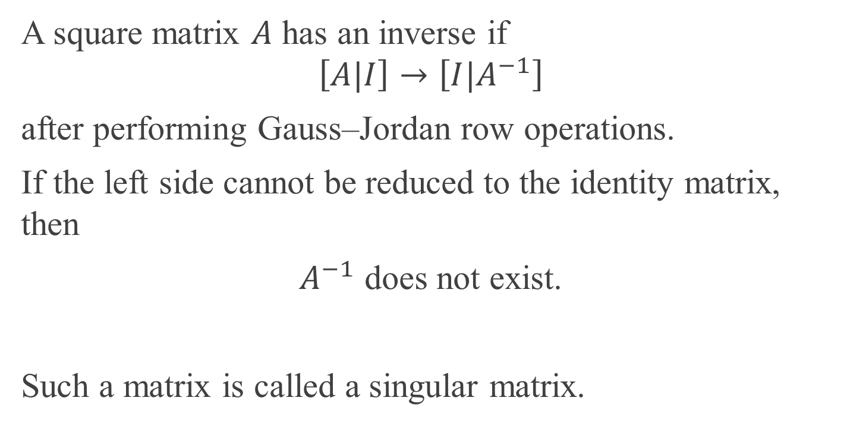
Condition for Matrix Inverse
A square matrix $A$ has an inverse if
$$\left[A|I\right]→\left[I|A^{−1}\right]$$
after performing Gauss–Jordan row operations.
If the left side cannot be reduced to the identity matrix, then
$A^{−1}$ does not exist.
Such a matrix is called a singular matrix.

Slide 16

.
Form the Augmented Matrix
Start with
$$\left[A|I\right]$$
$$\left[\begin{matrix}\begin{matrix}1 & 2 & −3 \\ 1 & −2 & 1 \\ 5 & −2 & −3\end{matrix} & \begin{matrix}| \\ | \\ |\end{matrix} & \begin{matrix}1 & 0 & 0 \\ 0 & 1 & 0 \\ 0 & 0 & 1\end{matrix}\end{matrix}\right]$$

Slide 17
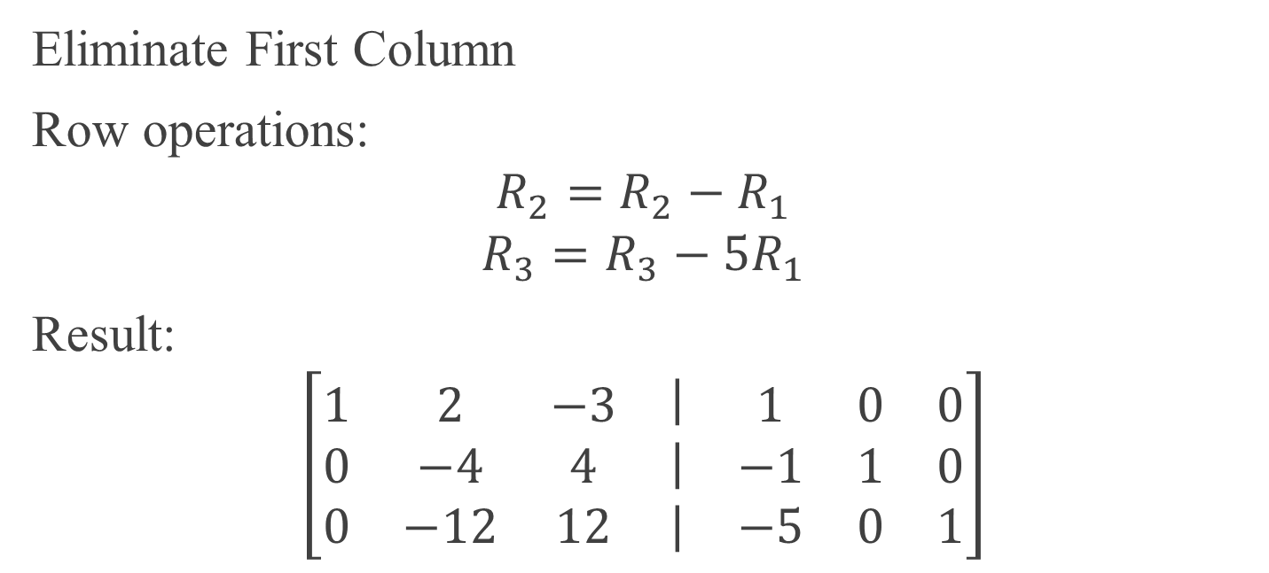
.
Eliminate First Column
Row operations:
$$R_{2}=R_{2}−R_{1}$$
$$R_{3}=R_{3}−{5R}_{1}$$
Result:
$$\left[\begin{matrix}\begin{matrix}1 & 2 & −3 \\ 0 & −4 & 4 \\ 0 & −12 & 12\end{matrix} & \begin{matrix}| \\ | \\ |\end{matrix} & \begin{matrix}1 & 0 & 0 \\ −1 & 1 & 0 \\ −5 & 0 & 1\end{matrix}\end{matrix}\right]$$

Slide 18

.
Next operation:
$$R_{3}=R_{3}−{3R}_{2}$$
Result:
$$\left[\begin{matrix}\begin{matrix}1 & 2 & −3 \\ 0 & −4 & 4 \\ 0 & 0 & 0\end{matrix} & \begin{matrix}| \\ | \\ |\end{matrix} & \begin{matrix}1 & 0 & 0 \\ −1 & 1 & 0 \\ −2 & −3 & 1\end{matrix}\end{matrix}\right]$$

Slide 19
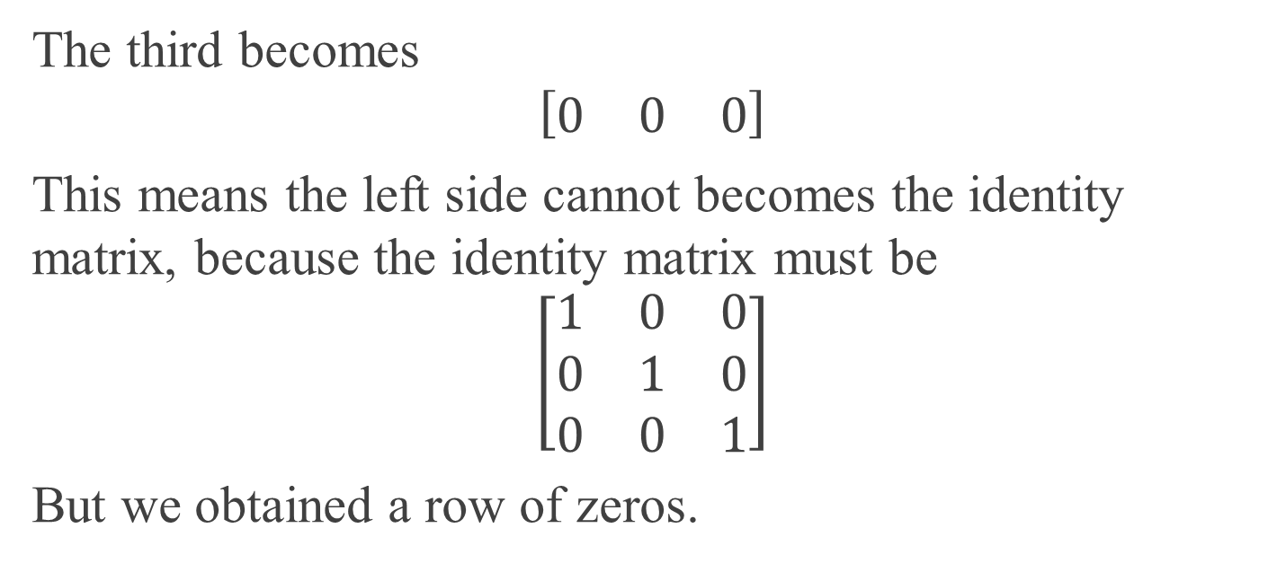
.
The third becomes
$$\left[\begin{matrix}0 & 0 & 0\end{matrix}\right]$$
This means the left side cannot becomes the identity matrix, because the identity matrix must be
$$\left[\begin{matrix}1 & 0 & 0 \\ 0 & 1 & 0 \\ 0 & 0 & 1\end{matrix}\right]$$
But we obtained a row of zeros.

Slide 20
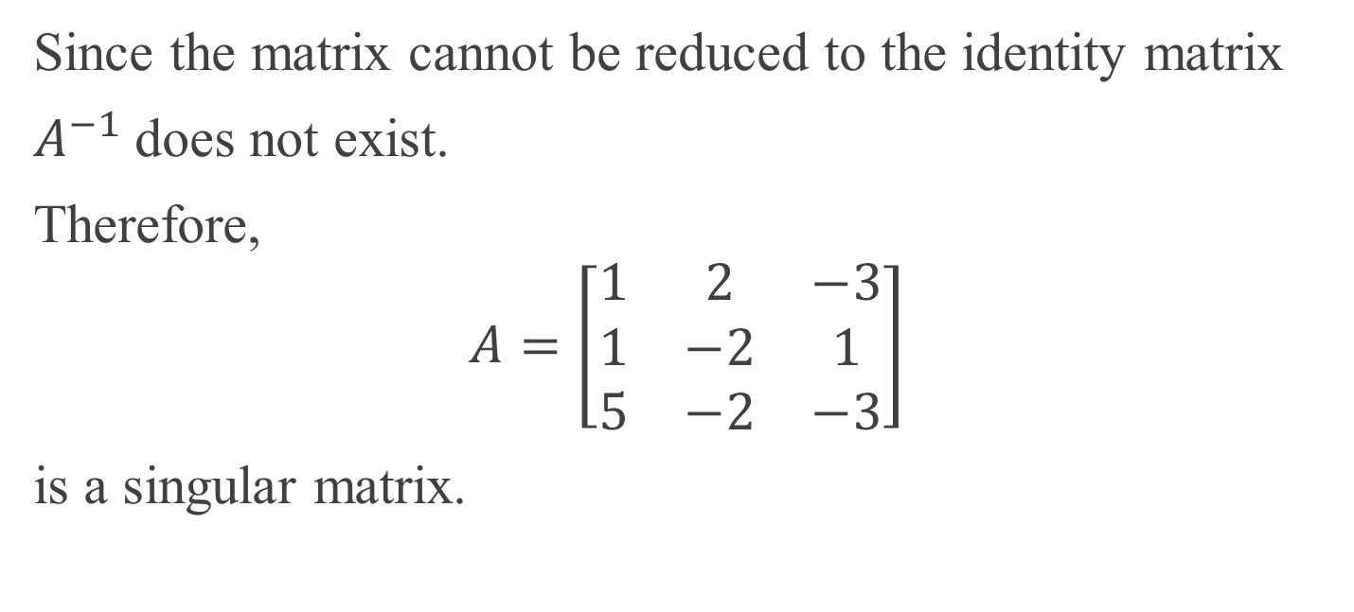
.
Since the matrix cannot be reduced to the identity matrix
$A^{−1}$does not exist.
Therefore,
$$A=\left[\begin{matrix}1 & 2 & −3 \\ 1 & −2 & 1 \\ 5 & −2 & −3\end{matrix}\right]$$
is a singular matrix.

